Slide 1

Building One-Shot Semi-supervised (BOSS) Learning up to Fully Supervised Performance
Leslie N. Smith
Naval Center for Applied Research in Artificial Intelligence
US Naval Research Laboratory, Washington, DC 20375
leslie.smith@nrl.navy.mil; Phone: (202) 767-9532
Behesda Artificial Intelligence Meetup
August 16, 2020
DISTRIBUTION A. Approved for public release: distribution unlimited.
Notes:
Good morning. I’m LNS from NRL’s NCARAI. Today I will discuss my recent work on 1-S SSL. The primary goal my research was to achieve comparable performance with labeling only 1 example/class as the performance with labeling thousands of examples/class.

Slide 2
Outline
Introduction
Motivation
Semi-supervised learning (SSL)
A hybrid that combines benefits from supervised learning and unsupervised learning
One-shot semi-supervised learning (1-S SSL)
Empirical observations of 1-S SSL
Building up One-Shot Semi-supervised (BOSS) learning
Prototype refinement
Class balancing
Self-training
Results
Insights
Notes:
This slide summarizes the topics of my talk. I will present a slide as to why I think this achievement is important. There is another slide on how I define and understand SSL. Then I will get into the details of our work on 1-S SSL. In particular, our investigation started with interesting empirical observations of 1-S SSL that directly lead to our BOSS methods. I will describe the 3 BOSS techniques of prototype refinement, class balancing, and self-training. Finally I will present my results and end with some insights.

Slide 3
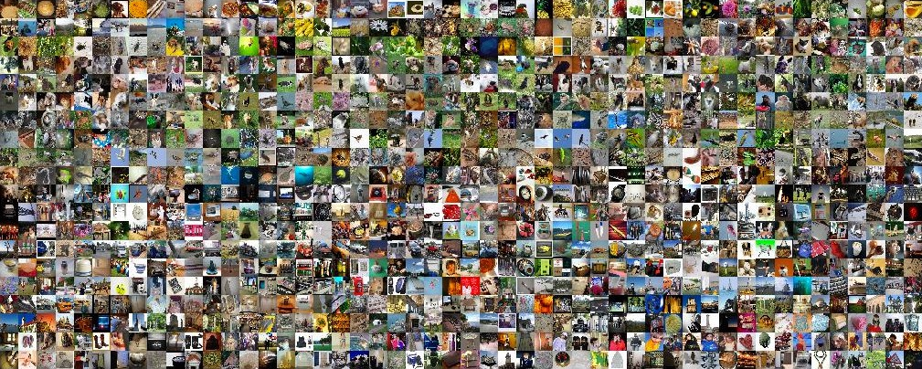
Motivation
Introduction
Three key elements for training neural networks
1) Algorithms, 2) computational resources
3) Hundreds to millions of labeled training/validation samples
In typical user scenarios one has plenty of samples but LABELING is burdensome
Our goal is to minimize the burden of labeling and achieve performance comparable to supervised learning
Notes:
It is universally known that there are 3 key ingredients for deep learning: the algorithms, heavy duty computational resources, and thousands of labeled training samples. Of these 3, the greatest barrier to new DL applications is the chore of manually labeling huge numbers of training data. On the other hand, the typical scenario for a new application is where one has lots of unlabeled data but little time for labeling. So the ideal scenario is to make labeling a trivial effort. Today I will describe how to obtain performance comparable to fully supervised learning while only labeling 1 training example/class.

Slide 4
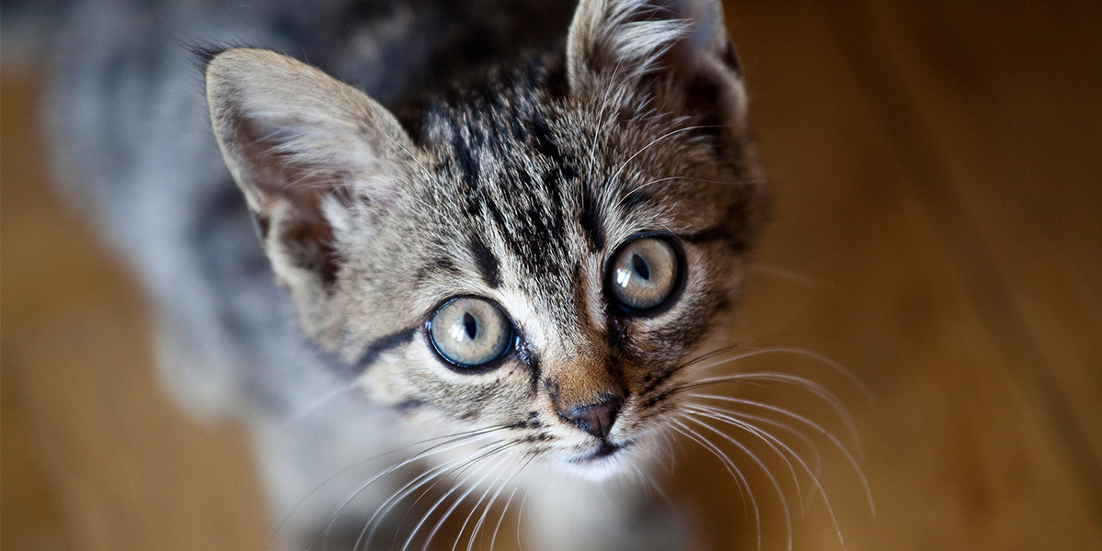
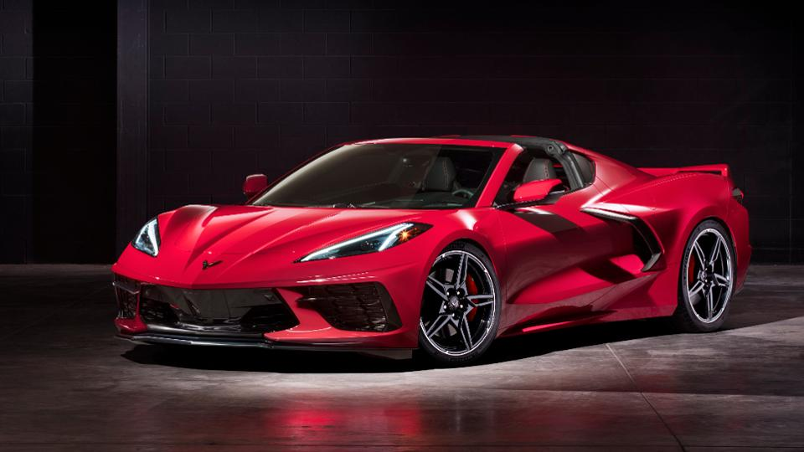
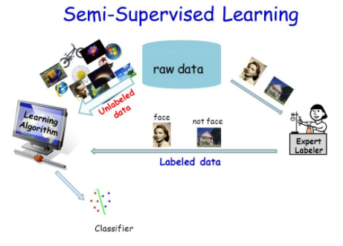
Semi-supervised learning
Semi-supervised learning
Supervised learning
Train with labeled training samples to train a network for a specific task
Unsupervised learning
Train with unlabeled training samples for representation learning
Semi-supervised learning (SSL)
Train with a small amount of labeled data plus a large amount of unlabeled data
Labeled data defines the task
Unlabeled data for representation learning
Avoids overfitting
Cat
Car
Notes:
Supervised learning is where we train on only labeled training samples and labels are needed to define the desired task; such as differentiating between a cat and a car. In unsupervised learning we train with only unlabeled samples and the goal is for the network to learn to transform the input into representations that can be useful for downstream tasks. SSL combines the best of both: use a small amount of labeled data, specifically to define the relevant task and use lots of unlabeled data to help learn representations that improve generalization and avoid overfitting the labeled data.
Obviously, the smallest amount of labeled data one can use in training is only 1 example/class and I will describe my efforts to reach this ideal.

Slide 5
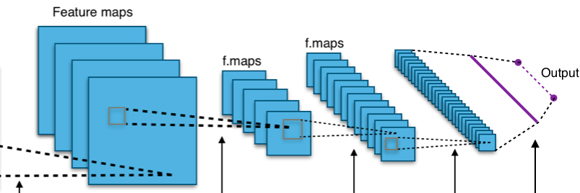
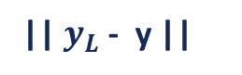
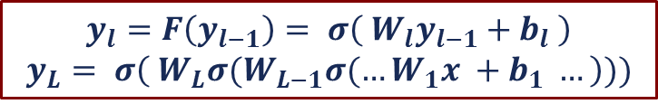

Deep Learning Basics
Background
Uses a neural network composed of many “hidden” layers, $l;$ each layer contains trainable weights, $W_{l}$, and biases, $b_{l}$, and a non-linear function, σ
Image x is input and output y is compared to the label, which defines the loss
Outline
$$y_{l}=F\left(y_{l−1}\right)= σ\left( W_{l}y_{l−1}+b_{l} \right)$$
$$y_{L}= σ\left( W_{L}σ(W_{L−1}σ(…W_{1}x +b_{1} …\right)))$$
Classes
}
Speed limit 20
Label
Pedestrian crossing
Yield
Loss
|| $y_{L}$ - y ||
Input x
Weights
Back-propagation
Vanishing Gradient
Notes:
In this one slide I will remind you of what you will need to know about training neural networks. They are composed of layers and each layer takes as input the output from the previous layer. It is multiplied by a matrix W that is composed of trainable weights, and we add a vector of trainable biases. The results are acted upon by a non-linear function to produce the output of the layer. If you do this recursively, you start with some input X and the network outputs y_L.
This is easier to understand pictorially. You have an image X that has a label that says this is a speed limit sign and not any of the other possibilities. This input is fed through the network and what comes out is different from the label. The error between the two is called the Loss and this loss is back propagated through the network, modifying the weights and biases so that the next time you feed this image through the network what will come out is closer to the label.
`

Slide 6
Semi-supervised learning
Semi-supervised learning
State-of-the-art in SSL: FixMatch
Consistency regularization: the model should output the same predictions on perturbed versions as on the original image
Pseudo-labeling: use the model to obtain pseudo-labels for samples whose probability are above a predefined threshold.
Loss function: L = L_{s} + λ_{u} L_{u}
Supervised loss term
Unsupervised loss term
Notes:
Any investigation needs to start with the SotA methods and last January, I found FixMatch to be a SotA method for SSL and chose it as my starting point. It is also somewhat simple; primarily being based on consistency regularization with some pseudo-labeling thrown in too. The idea with CR or also known as consistency training is to train the network to make the same prediction on augmented versions of an unlabeled image as on the original image. Consistency training has become quite popular this year in unsupervised and semi-supervised training. It builds on invariant image transformations, such as weak to strong data augmentation methods. Pseudo-labeling is where one uses the model to guess labels for the unlabeled samples and use confident samples for training. The FixMatch loss function is a combination of the supervised and unsupervised terms. The supervised loss is simply the common cross-entropy softmax loss, represented by H.

Slide 7
Semi-supervised learning
Semi-supervised learning
Loss function: L = L_{s} + λ L_{u}
Supervised loss term
Unsupervised loss term
Notes:
The unsupervised loss is shown here pictorially where we weakly augment an image, run it through the model and if the prediction is confident we assign the image with this pseudo-label. The same image is also strongly augmented, fed through model and the loss compares this prediction to the pseudo-label. The equation represents these parts thus….

Slide 8
Empirical Observations
One-shot semi-supervised learning
Cifar-10 1-S SSL results
4 random samplings: 49% – 85%, mean 64%
8 samplings from high to low quality: 78% to 10% test accuracy, respectively
Smith, Leslie N., and Adam Conovaloff. "Empirical Perspectives on One-Shot Semi-supervised Learning." arXiv preprint arXiv:2004.04141 (2020).
Notes:
Now I want to transition to our empirical observations that lead to BOSS. The FixMatch paper described some experimentation with1-S SSL on Cifar-10 data but they relied on the labels to take random samplings of each class and they obtained final test accuracies in a large range from 49 – 85%. They even used a supervised model to choose 8 samplings (1/class) from high quality to low quality and stated that training with the high quality samples produced a network with 78% test accuracy while training with the low quality samples failed to converge at all. The images here show examples of high quality samples and to the human eye, look to be good quality. A lesson here is that what you use for a class prototype matters. When we investigated 1S SSL further, we discovered an interesting phenomenon, which is recorded in our paper posted on arXiv. This table lists the results of 6 training runs using 1S SSL with random prototypes. On the left you see the range on test accuracies go from 45 – 71%. When we next looked at the test accuracies for each class, we found something fascinating. Some of the class accuracies were near 100% and others were close to 0. And within a given class, there were large variations, which again reinforces the lesson that what you use for a class prototype matters.

Slide 9
Empirical Observations
One-shot semi-supervised learning
Cifar-10 results
4 random samplings: 49% – 85%, mean 64%
8 samplings from high to low quality: 78% to 10%, respectively
Smith, Leslie N., and Adam Conovaloff. "Empirical Perspectives on One-Shot Semi-supervised Learning." arXiv preprint arXiv:2004.04141 (2020).
Notes:
Also we looked at the class accuracies during the training and discovered that the differences between classes can change during training and that the training of some classes can be unstable, which I will discuss near the end of this presentation. So what does all this mean and how can we use it? In particular, if you think about it, the greatest benefit can come from improving the performance of the weakest classes. With a little bit of thinking one realizes that during training some classes get behind and the model will rarely predict these weak classes for the unlabeled data. Hence, it is difficult with only 1 example/class to overcome this early deficit.

Slide 10
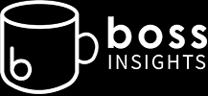
One-shot semi-supervised learning
Lessons learned
Class prototypes matter
Class imbalance hurts performance, hence provides an opportunity for improved performance
Building up one-shot semi-supervised (BOSS) learning
Prototype refining
Class balancing methods
Self-training
Smith, Leslie N., and Adam Conovaloff. "Building One-Shot Semi-supervised (BOSS) Learning up to Fully Supervised Performance." arXiv preprint arXiv:2006.09363 (2020).
Notes:
In summary, we learned from the previous experiments that good class prototypes matter and there are large differences in class performances. These insights lead us to the first two methods in BOSS; prototype refining and class balancing methods. In addition, self-training can be used to get a final bump in performance to fully supervised level, as will be demonstrated shortly.

Slide 11
Prototype refining
One-shot semi-supervised learning
Visually choose iconic class prototypes
Replace prototypes for poorly performing classes
Print class accuracies in training run
Prototype set 3 shows how performance
Replace 2 prototypes in sets 2 and 4 to produce sets 6 and 7
Notes:
In real-world scenarios, one's data is initially all unlabeled but it is not overly burdensome for an expert to manually sift through some of their dataset to find one iconic example of each class. In choosing iconic images, the labeler's goal is to pick images that represent the class objects well, while minimizing the amount of background distractors in the image.
In our own experiments with Cifar-10, we did not rely on the labels but reviewed a small fraction of the training data to manually choose class prototypes. This table shows test accuracies for 5 such sets. As opposed to results shown on slide 7 where randomly picking samples produced accuracies in the 45-71% range, this small amount of effort provides total test accuracies in the range of 72 – 86%, which is a significant improvement. The class accuracies show that some of the classes still don’t perform well. With the small amount of additional effort of replacing only 2 of the prototypes for weak classes in sets 2 and 4, we have sets 6 and 7 where the total accuracies to 82-83% range. This iterative replacement of prototypes is what I named prototype refinement. It does not need to be limited to replacing 2 prototypes or just 1 iteration but I did this here for consistent comparisons.

Slide 12
Class balancing
One-shot semi-supervised learning
Class balancing methods from data imbalance literature
Over-sampling minority classes, under-sampling majority classes
Overweighting minority classes, underweighting majority classes
Hybrid of data over/undersampling and loss over/underweighting
Oversampling minority classes
Count the number of pseudo labels in each class
C = c_{n}: n Є (1,…,N), where N is the number of classes
Use a class-based threshold in unlabeled loss:
Where the class-based threshold is:
Notes:
Next we investigated using methods that can be found in the class imbalance literature, which encourages consistent accuracies across all the classes when there are major differences in the number of training examples in each class. I want to point out that these are known methods but I am using them in a brand new context; that is, on unlabeled data.
The class balance methods primarily fall into 2 categories. The first is data oriented, which is to over-sample minority classes and under-sample majority samples. This is an effort to balance the data used for training even though the dataset might be highly skewed. The second is algorithmic and it is to modify the loss function to weight the minority classes more than the majority classes. Of course, one can try hybrids of both types of methods.
In our work, we studied the impact of 4 methods for class balancing on 1-S SSL. The first is a way to oversample the minority classes. Unlike the labeled data imbalance problem, with unlabeled data, how are we to know which are the minority and majority classes? The method I came up with for knowing which classes are in the minority is to compute pseudo labels for all the unlabeled data and count the predictions as to how many are in each class. Then we modified our loss function such that the confidence threshold depended on the number of predicted labels. The equation we used is shown as tau_n and it was designed such that the most frequent class will use a threshold of tau while minority classes will use lower thresholds.

Slide 13
Class balancing
One-shot semi-supervised learning
Underweighting loss terms for majority classes
Use all the pseudo-labels in the unlabeled mini-batch
Compute c_{n} with all the pseudo-labels
where c_{n} weights each contribution and Z is a normalization factor
Use only the pseudo-labels of samples above the threshold
Compute c_{n} with pseudo-labels above the threshold
Since L_{u} only includes pseudo-labels of samples above the threshold, each class contributes an equivalent amount
Hybrid combines oversampling minority and underweighting majority classes
Combining class balance methods 1 and 3
Notes:
The next two methods lowers the contribution to the loss function for the majority classes. As can be seen by this equation, each term of the unlabeled loss is divided by the count of the number of examples in that class. Hence, the more predictions in a class, the lower the contribution of each term.
The only difference between methods 2 and 3 is that in 3 we compute the class counts of pseudo-labels of samples with predictions above the threshold while method 2 counts all of the pseudo-labels. Method 3 makes sense as it allows each class to actually contribute an equivalent amount to L_u but the weights in method 3 can have large swings, so we tested both. Method 4 is a a combination of class balance methods 1 and 3.

Slide 14
Self-training
One-shot semi-supervised learning
Labeled and unlabeled data play different roles
Highest confidence unlabeled pseudo-labels become labeled examples for a new training run
Although some labels might be wrong, deep networks are robust to low levels of labeling noise
We aimed to achieve near 90% accuracy for the first iteration
Notes:
As a final step, we used self-training for a final boost to achieve the same levels of test accuracy as supervised learning. Self-training is a standard SSL technique where a trained model is used to create labels for the highest confidence unlabeled examples and they are combined with the labeled samples for training a new network. This differs only a little from pseudo-labeling but labeled data plays a different role than unlabeled data so it matters. As for the issue that some of the labels might be wrong, DNNs are robust to low levels of labeling noise and we were targeting obtaining near 90% accuracy on the first iteration and such a small level of label noise does not hurt and could even improve the generalization performance. In addition, we sort the predictions and label only the highest confidence samples of those unlabeled samples used in the training, which are likely to have a much higher accuracy than the test accuracy for two reason: these are the highest confidence samples and the network was trained on them.

Slide 15
Main results
One-shot semi-supervised learning
Fully supervised test accuracy = 94.9 ± 0.3%
Notes:
This table shows our main results. As before, sets 1 -5 are class prototypes picked visually. Sets 6, 7 are improved with prototype refining by replacing 2 poorly performing class prototypes. The results reported in this table are the accuracies for the entire Cifar-10 test set, where we provide the average and STD of 4 runs. The second column is for FixMatch performance with prototypes, which shows improvement over the original FixMatch results.
The next 4 columns shows the test accuracies for each of the 4 class balancing methods. These results demonstrate that the class balancing methods provides substantial improvement over the FixMatch with prototypes results. Set 3 is interesting because it shows that a good choice of prototypes has the potential to produce good results and adding class balancing improves the performance to over 90%. Similarly, when using prototype refining, as in sets 6, 7, class balancing uniformly improves the test accuracies to over 90%.
The final 4 columns show the performance of self-training by adding 5, 10, 20, or 40 examples/class to the original 1 labeled sample/class. Here we took the model from the runs shown in bold, fed the unlabeled data through the model, sorted the results and perform self-training using the most confident predictions as additional labeled examples. It is clear that these results are quite close to the results for the fully supervised results for this model of 94.9+-0.3%. Finally, I’d like to point out that these results were obtained using a modification of the original TensorFlow implementation of FixMatch but I also modified a PyTorch reimplementation and the results for the reimplementation are reported in the square brackets. The PyTorch results are substantially different than the TF results, from which one can conclude that 1S SSL is a sensitive creature so we investigated this a bit further.

Slide 16
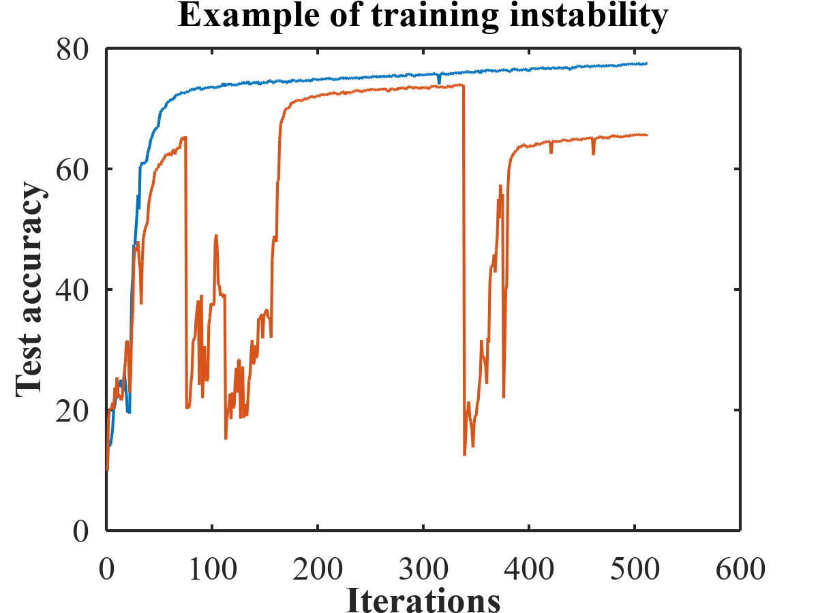
Hyper-parameter sensitivity
One-shot semi-supervised learning
Two causes for poor performance
Red curve: Instabilities
Blue curve: Poor minimum or prototypes
Good choices for the prototypes and prototype refining helped significantly
Notes:
1S SSL is not only sensitive to implementation, it is also sensitive to HPs. When we researched this, we discovered something quite interesting – that there are two fundamentally different causes for poor class performance. As we described earlier, sometimes there are instabilities during training as shown with the red curve. In addition, there are cases without instabilities that simply didn’t attain high accuracies. Generally this is due to poor class prototypes and can be significantly improved by prototype refining. In addition, we found that the HPs provide another way to improve the performance.

Slide 17
Hyper-parameter sensitivity
One-shot semi-supervised learning
Instability problems
Decrease the amount of class balancing by
Decrease WD, LR, and increase threshold τ
Balance methods 1, 4: Decrease Δ
Balance methods 2, 3: Decrease λ_{u}
Poor minimum problems
Increase the amount of class balancing by
Increase WD, LR, and decrease threshold τ
Balance methods 1, 4: Increase Δ
Balance methods 2, 3: Increase λ_{u}
Notes:
It turns out important to identify which of the 2 causes is responsible for the poor performance because the solution for each is the opposite of the other. For instability problems one wants to decrease the amount of class balancing. For the poor minimum problem, one wants to increase the amount of class balancing. This is demonstrated on the next slide.

Slide 18
Hyper-parameter sensitivity
One-shot semi-supervised learning
Notes:
Slide 15 shows that even with class balancing there are times when the performance is below 85%. We looked into those cases and most of them were due to instabilities, with the exception of set 4, which was caused by poor prototypes/minimum. The rules on the previous slide were used to tune the HPs as indicated and the results are shown in this table. Even small changes to the HPs has the potential to significantly improve performance, such as accuracy going from 80% to 94.5%.
This sensitivity can be viewed either as a problem or potentially as a benefit, which I will describe in the next slides.

Slide 19
One-shot semi-supervised learning
Labeling a large number of images is necessary for good performance
Training of all networks have a class imbalance problem and the brute force solution is use lots of training data
More elegant solutions are possible
One-shot semi-supervised learning provides opportunities to study the impact of a single sample
This opens opportunities to investigate the factors and features that help or hurt training performance
Notes:
Time to wrap up. I’d like to think that these results demonstrate that it is not necessary to label large numbers of images to reach high accuracies. In addition, I believe training has a fundamental imbalance problem and the brute force way to solve it is to use lots of labeled training data. However, more elegant solutions are possible and what I proposed here is just a start.
Next, I think 1S SSL opens up new opportunities to better understand the impact of features in a single training image; hence, we have the potential to learn what are good features and what are not good for training.

Slide 20
One-shot semi-supervised learning
Educational experience of training highly sensitive networks on hyper-parameter fine-tuning
Sensitivity of one-shot learning can be used with AutoML and Neural Architecture Search (NAS) to obtain optimal hyper-parameters and models.
In addition, we recommend that researchers test their novel architectures, loss and optimization functions on one-shot semi-supervised learning to better differentiate their methods
I am looking to test one-shot semi-supervised learning on real-world applications
Notes:
Furthermore, the high sensitivity of 1S SSL can be educational for those new to DL and want to learn about fine tuning. I’m also advocating running AutoML or NAS with 1S SSL to learn automatically find the best models and HPs. In addition, I will point out what I think a problem in the DL research community; all too commonly researchers compare their novel arch, loss, or opt functions on standard benchmarks, show an insignificant half percent improvement and declare a new SotA. IMO, comparisons in the realm of 1S SSL will better differentiate novel SotA methods.
Finally, I think these methods can be valuable and I am looking to test them on practical applications of these ideas.

Slide 21

One-shot semi-supervised learning
Outline
Questions and comments?
The End

